Slide 1


Revolutionizing Democracy: Exploring the Benefits and Challenges of Online Voting Systems

Slide 2

Skill Development Project
PFSD Final Review
Project – 14
Team Num - 1010

Slide 3

Our Team
2200030391 – K. Srinivas
2200030397 – M. HimaTeja
2200031991 – B. HimaTeja

Slide 4
Agenda
Introduction
Survey Results
Our Learning
Personas
Customer Journey Maps
Outputs
Conclusion

Slide 5
Specifications
Login for employee and voter
Add voter by employee
Change password by OTP verification
Cast your vote if not voted

Slide 6
Introduction
Revolutionizing Democracy: Exploring the Beneﬁts and Challenges of Online
Voting Systems

Slide 7


Traditional Voting Systems
Paper-based voting systems have been the norm for decades. They are time- consuming and expensive. They require a lot of resources to set up and maintain.

Slide 8

Benefits of Online Voting
Online voting is convenient, efﬁcient, and accessible. It can increase voter turnout and reduce costs. It can also be more secure and less prone to errors than traditional voting systems.

Slide 9
Survey Results

Slide 10
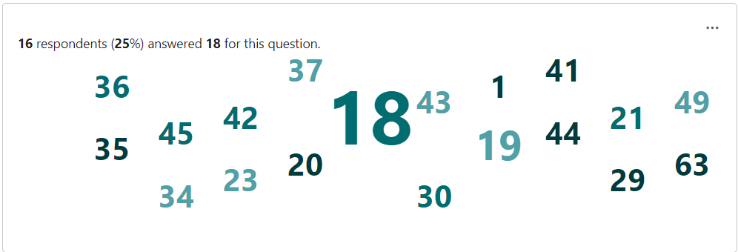
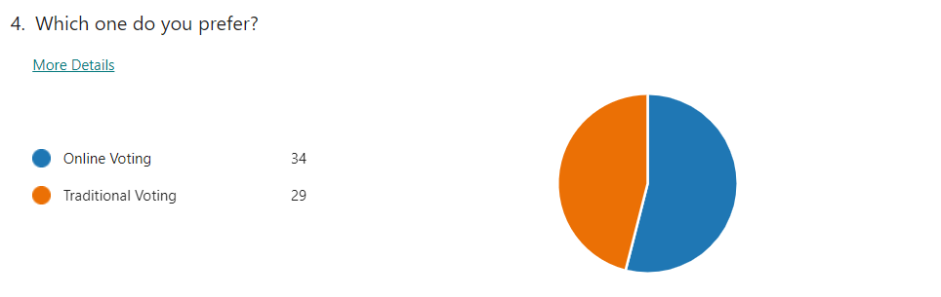
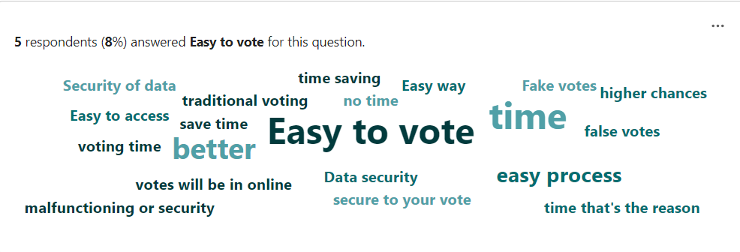

Slide 11
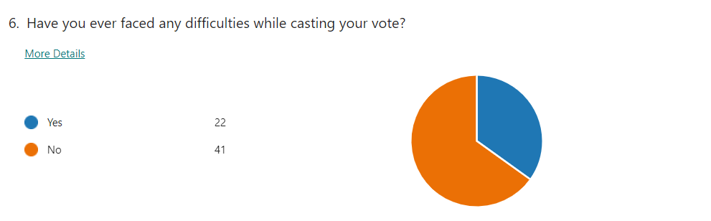
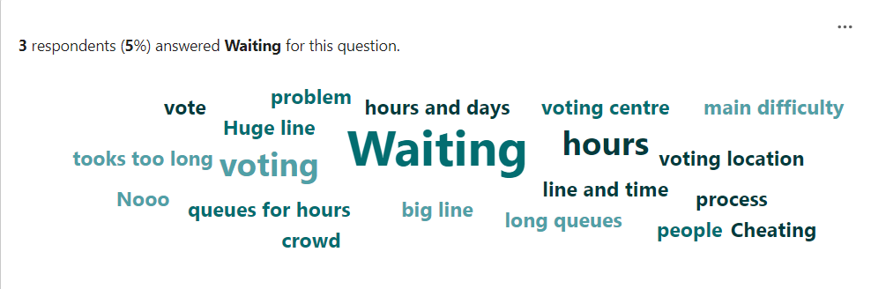
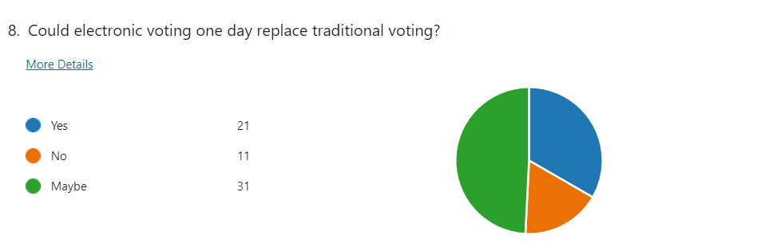

Slide 12
Our Learnings

Slide 13

Challenges of Online Voting
Online voting faces several challenges, including security concerns, voter authentication, and accessibility. There is also the risk of technical failures and cyber attacks.

Slide 14


Security Concerns
Online voting systems must be designed with robust security measures to prevent hacking, fraud, and other forms of cyber attacks. Encryption, multi-factor authentication, and blockchain technology can enhance security.

Slide 15


Voter Authentication
Online voting systems must ensure that voters are properly authenticated to prevent fraud. This can be done through various methods, such as biometric identiﬁcation, digital signatures, and unique login
credentials.

Slide 16



Accessibility
Online voting systems must be accessible to all voters, including those with disabilities and those who lack internet access. This can be achieved through various means, such as assistive technology and alternative voting methods.

Slide 17
Personas

Slide 18
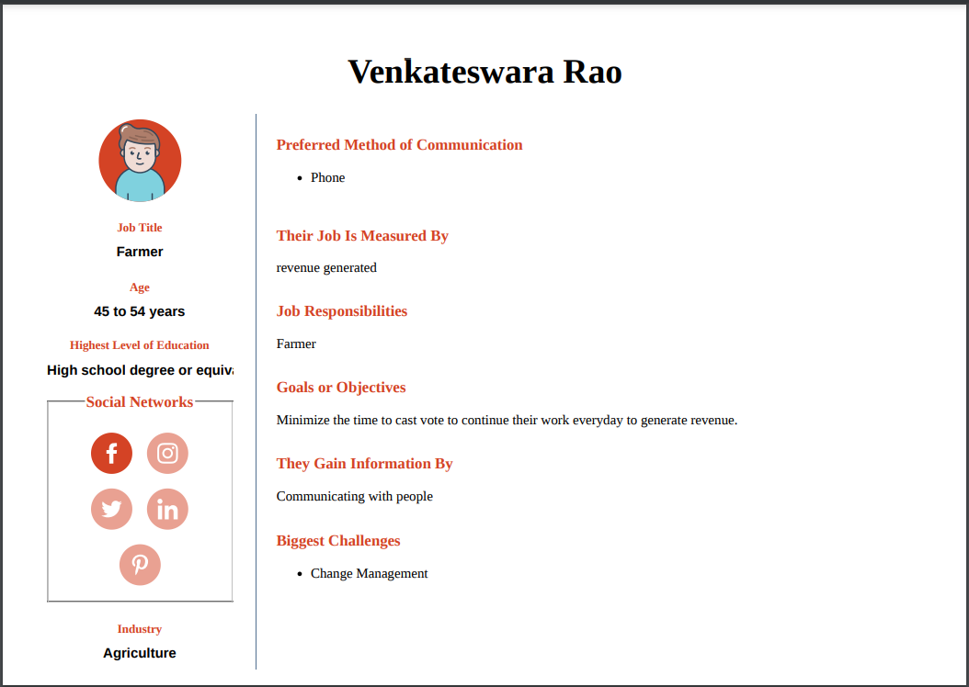

Slide 19
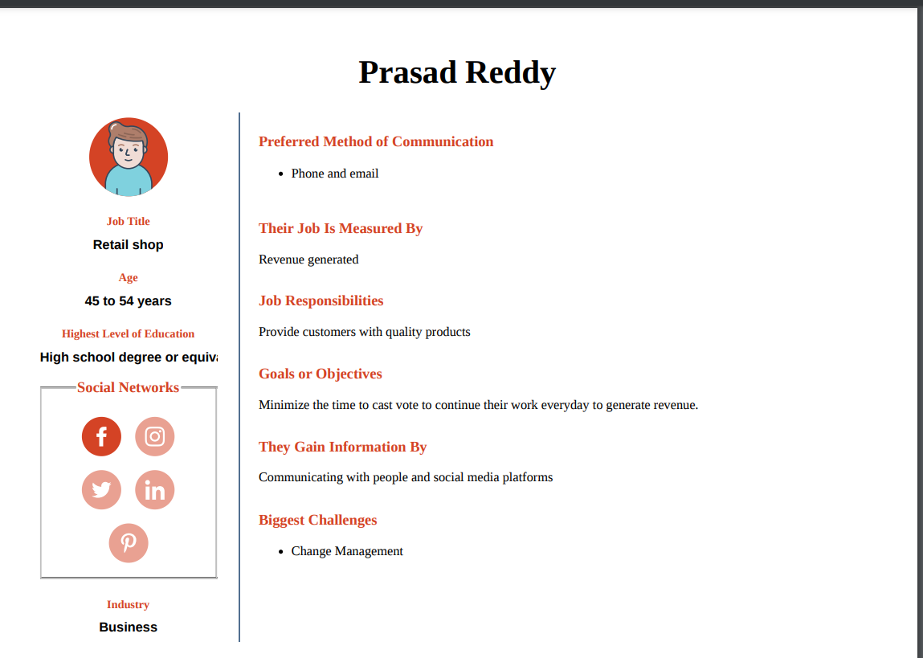

Slide 20
Customer Journey Map

Slide 21
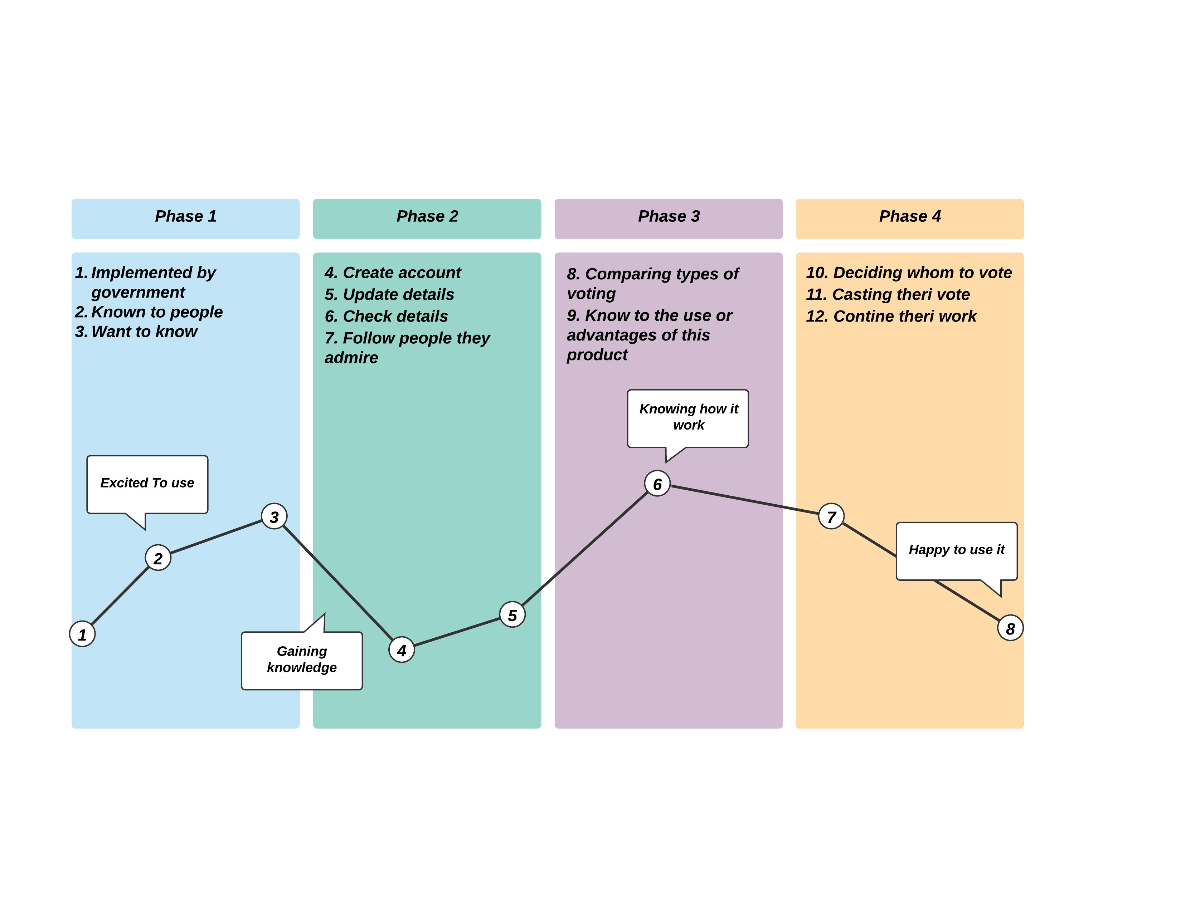

Slide 22
Outputs

Slide 23
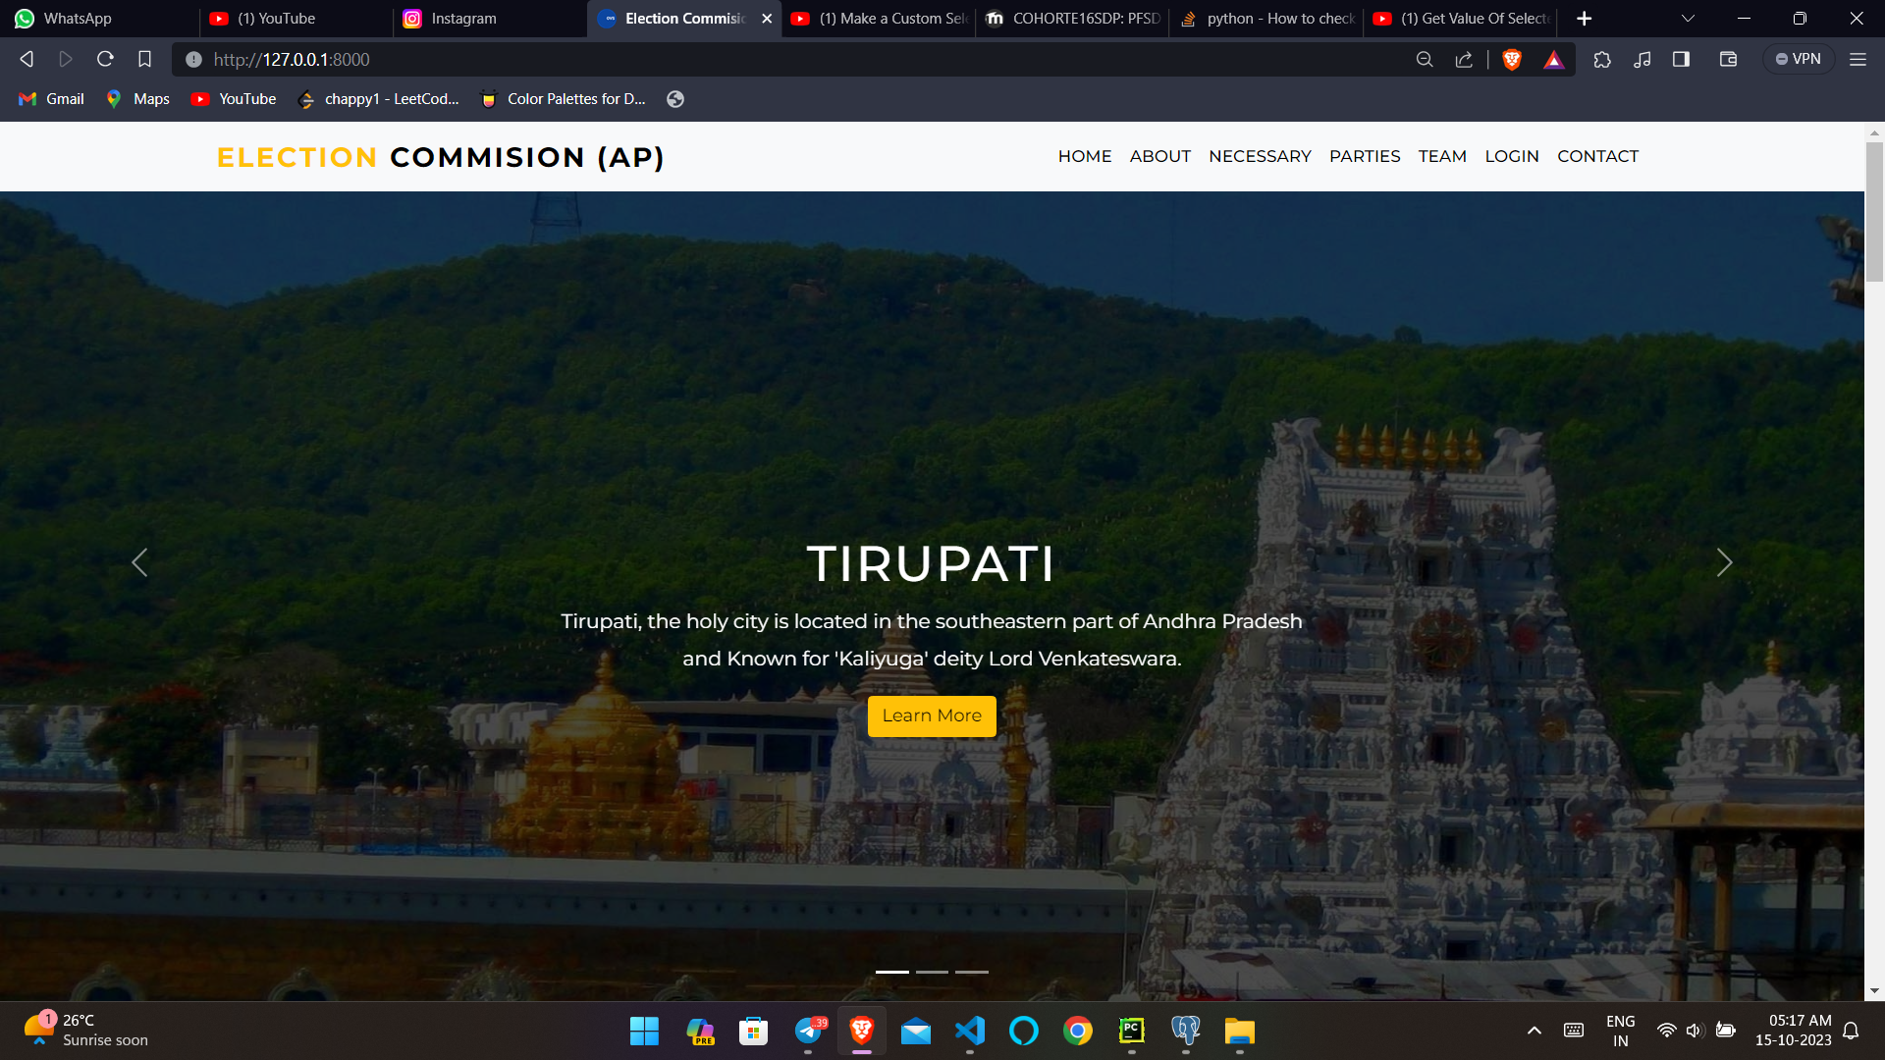

Slide 24
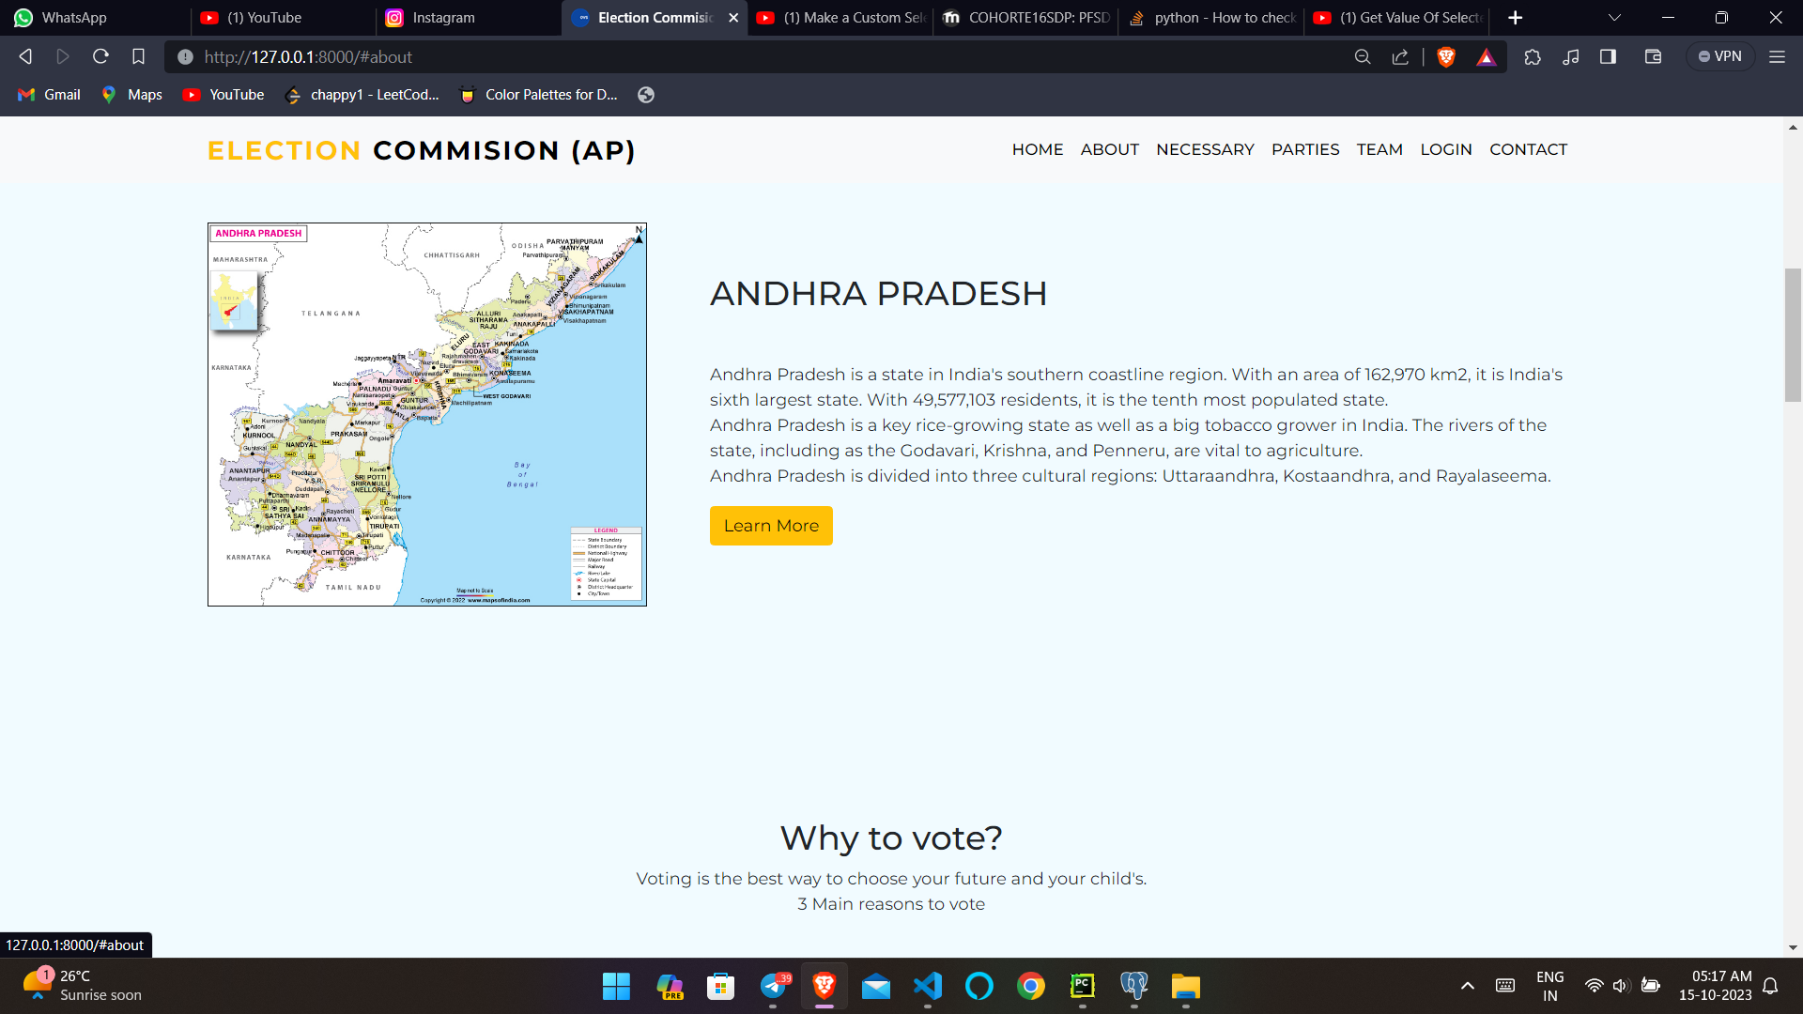

Slide 25
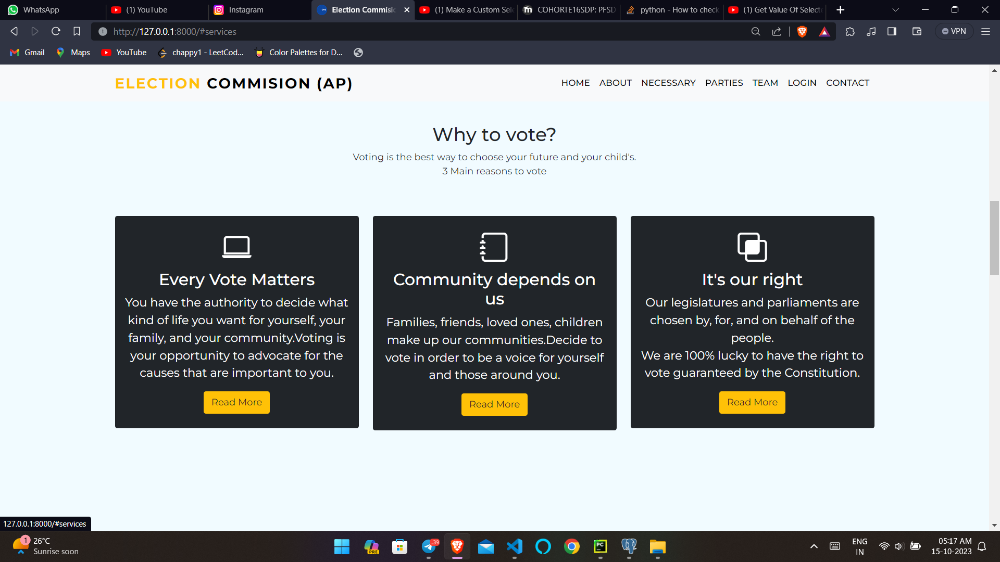

Slide 26
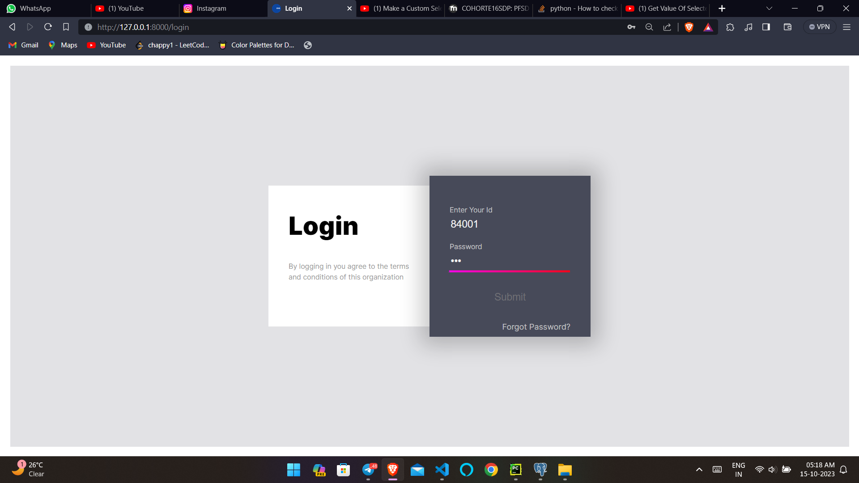

Slide 27
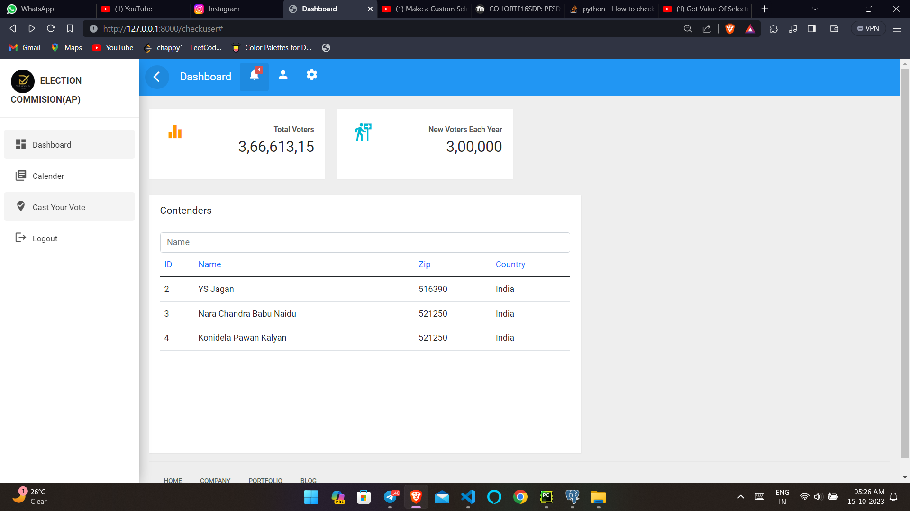

Slide 28
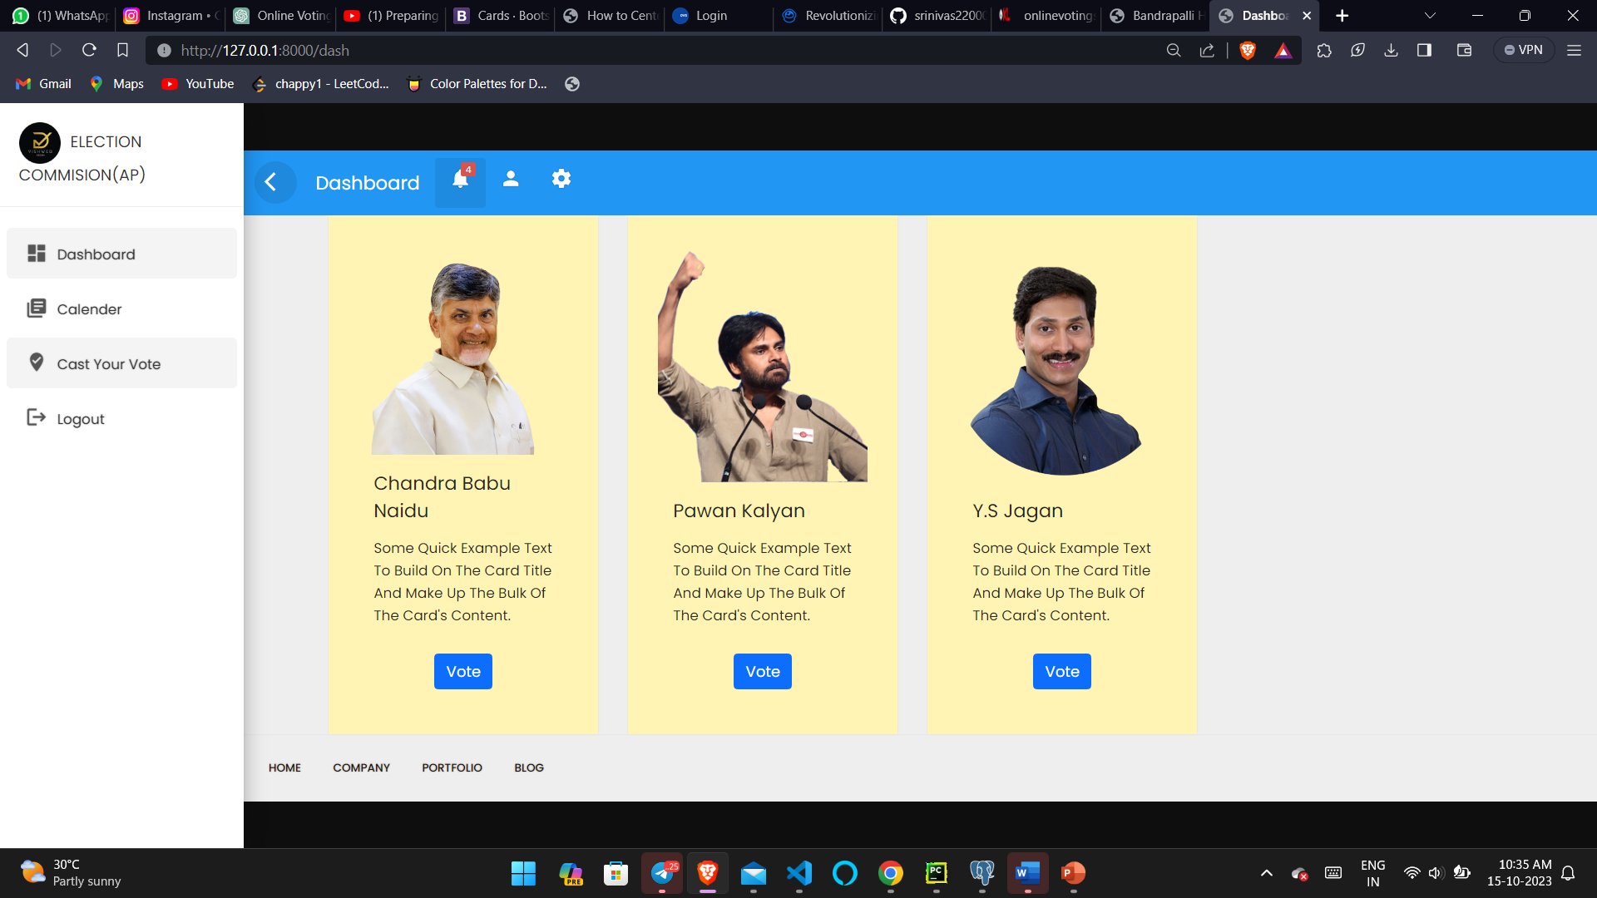

Slide 29
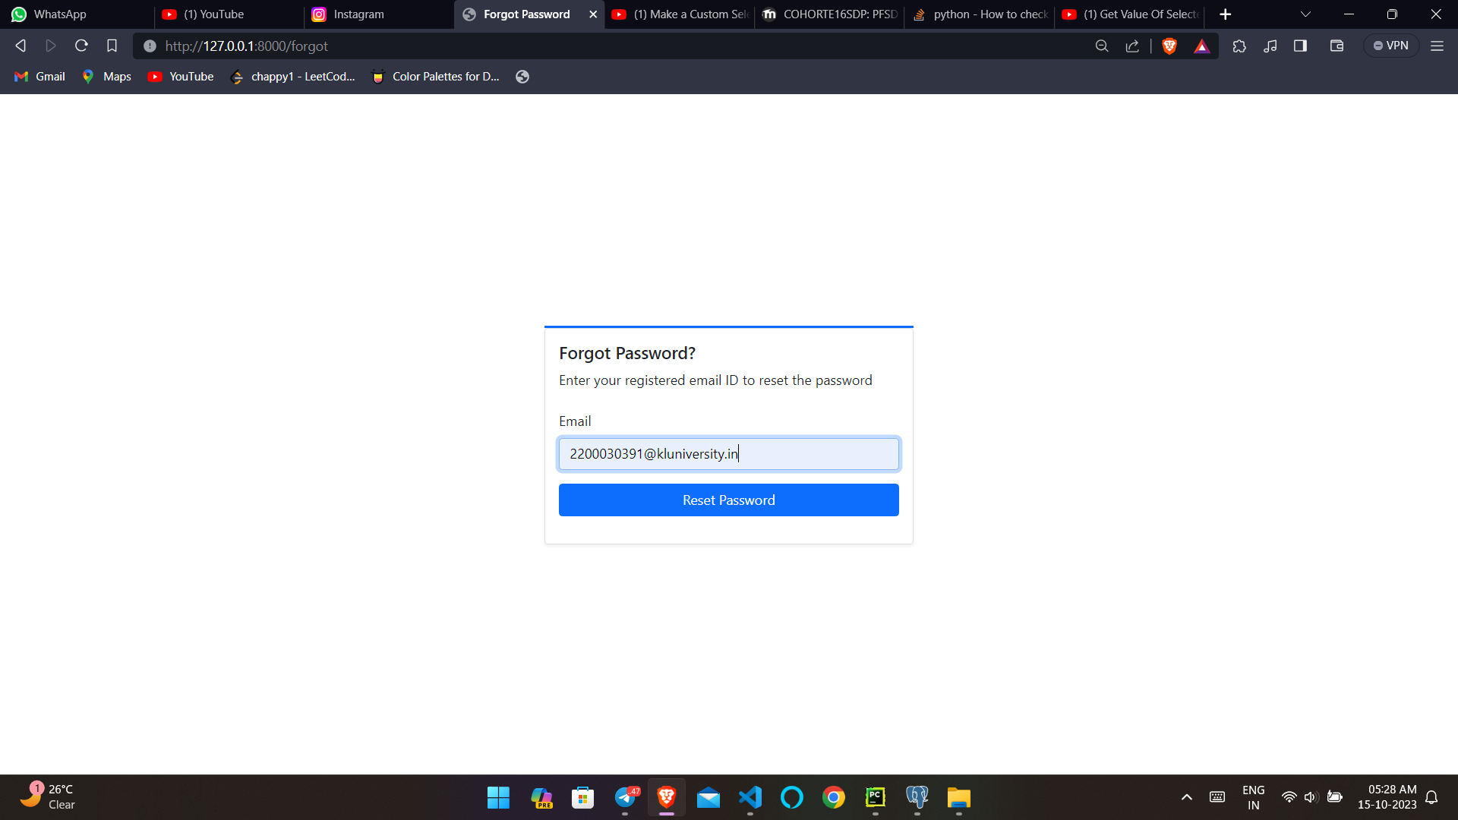

Slide 30


Slide 31
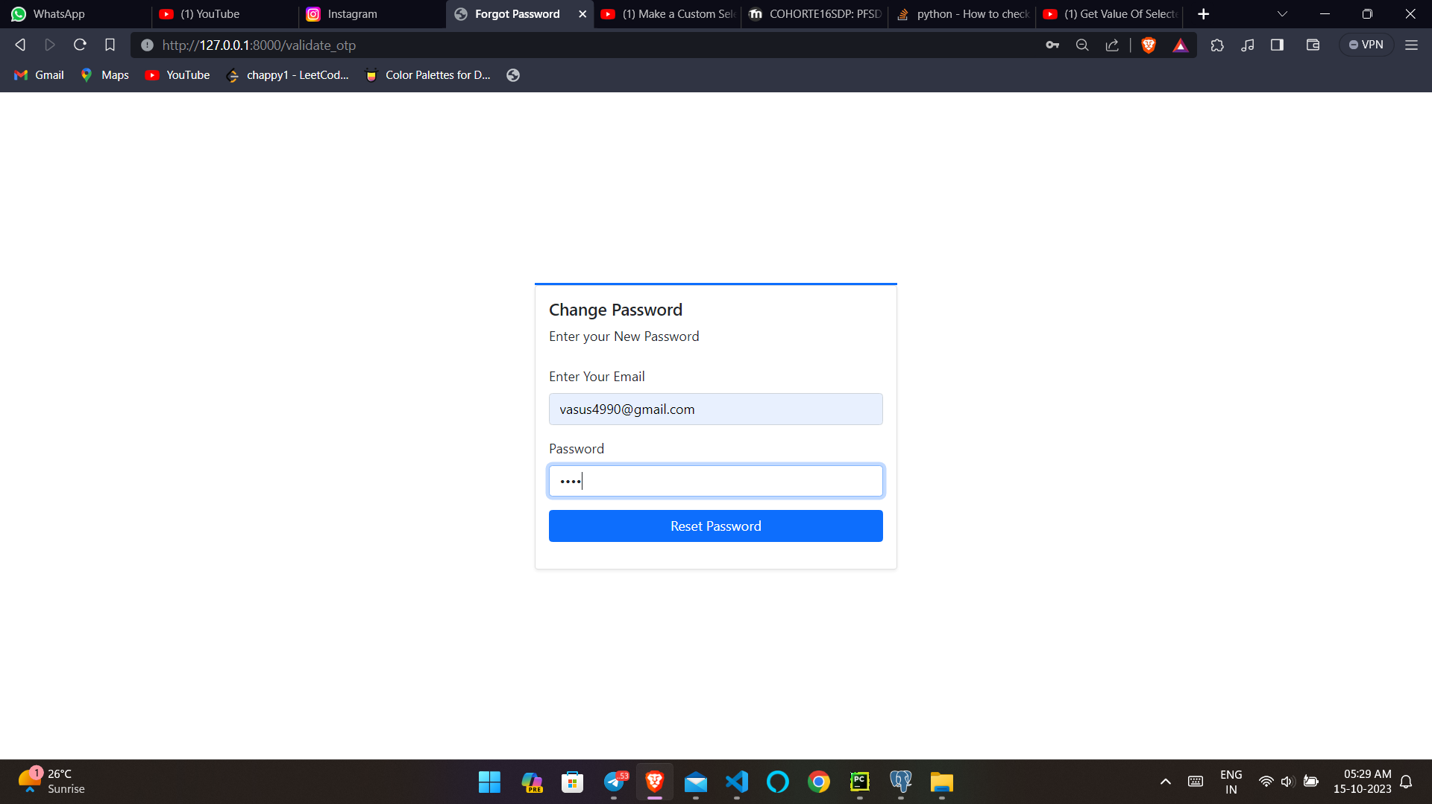

Slide 33
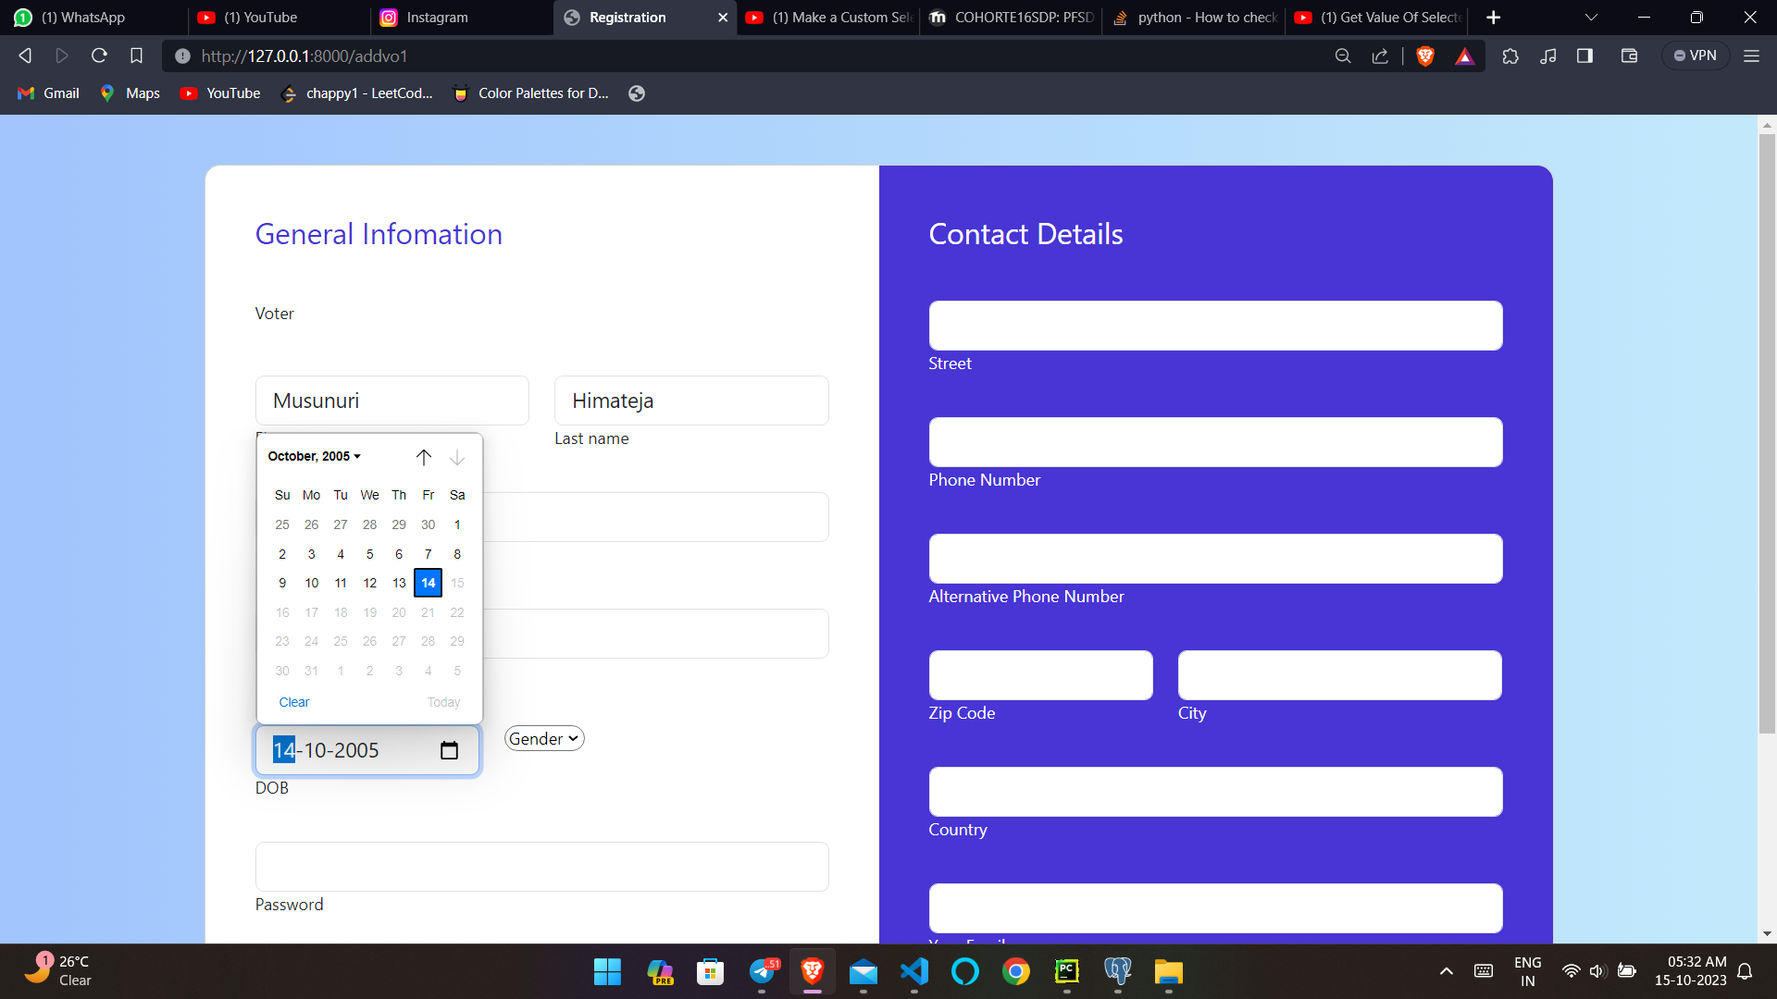

Slide 34
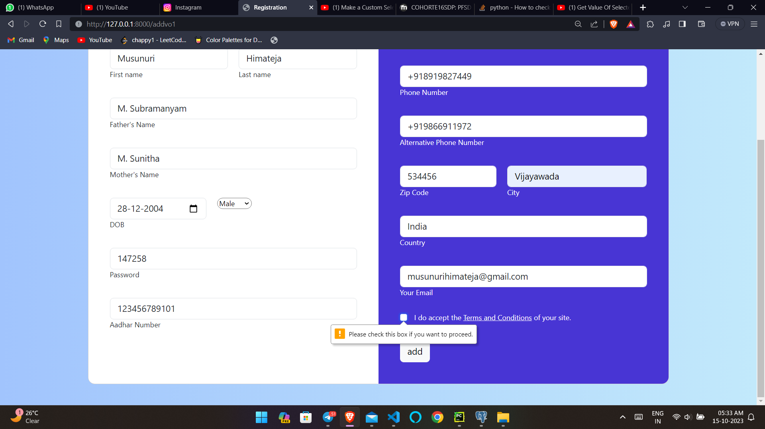

Slide 35
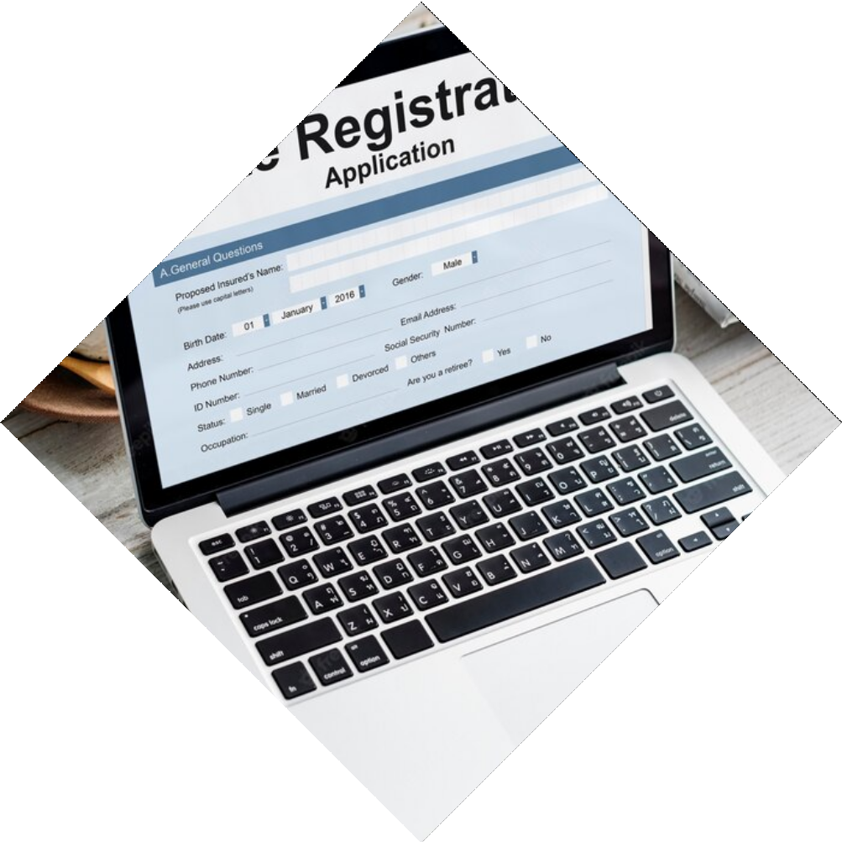

Case Studies
Several countries and organizations have experimented with online voting systems, including Estonia, Switzerland, and the state of West Virginia. These case studies provide valuable insights into the beneﬁts and challenges of online
voting.

Slide 36

Future of Online Voting
Online voting is likely to become more prevalent in the future, as technology advances and more people demand convenient and accessible voting methods. However, it is important to address the challenges and ensure that online voting systems are secure, reliable, and trustworthy.

Slide 37
Conclusion
Online voting has the potential to revolutionize democracy by making voting more convenient, efﬁcient, and accessible. However, it also faces several challenges, such as security concerns, voter authentication, and accessibility. By addressing these challenges, we can create secure, reliable, and trustworthy online voting systems that enhance democracy.

Slide 38
Thanks!

